Slide 1
Lab - Threat Protection

Slide 2
Wherein ...
We would like to implement checks on inbound JSON payloads to insure they conform to our known limits,
Thereby protecting our systems from JSON payload threats

Slide 3
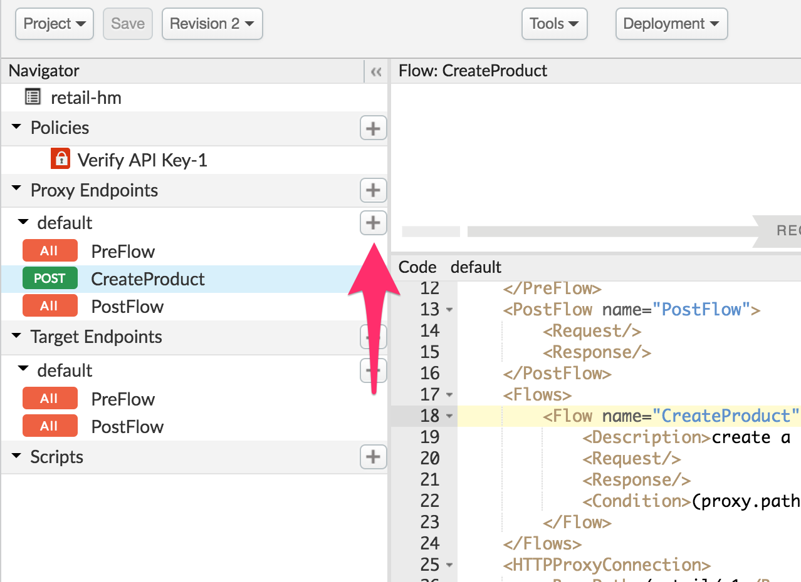
Create a POST resource or Conditional flow
Create a new POST resource in the
Proxy Endpoint

Slide 4
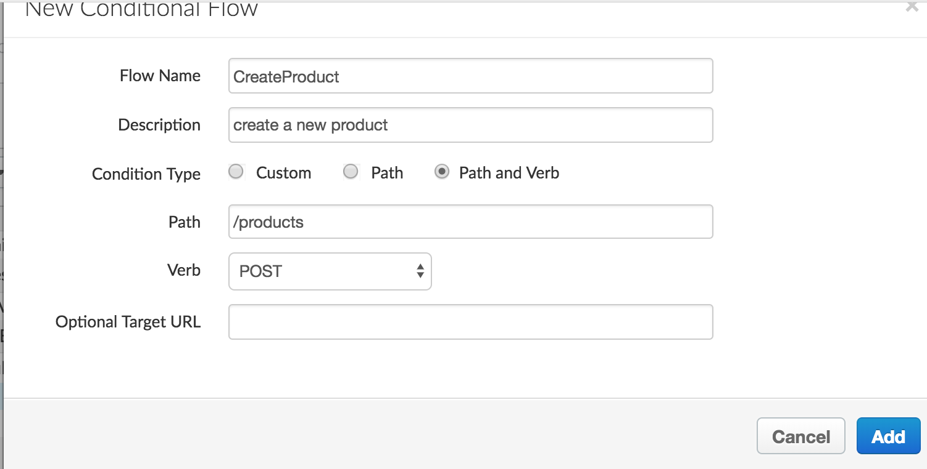
Create a POST resource or Conditional flow
Create a new POST resource in the
Proxy Endpoint
Condition Type:
path and verb
Verb: POST --
Path: /chefs

Slide 5
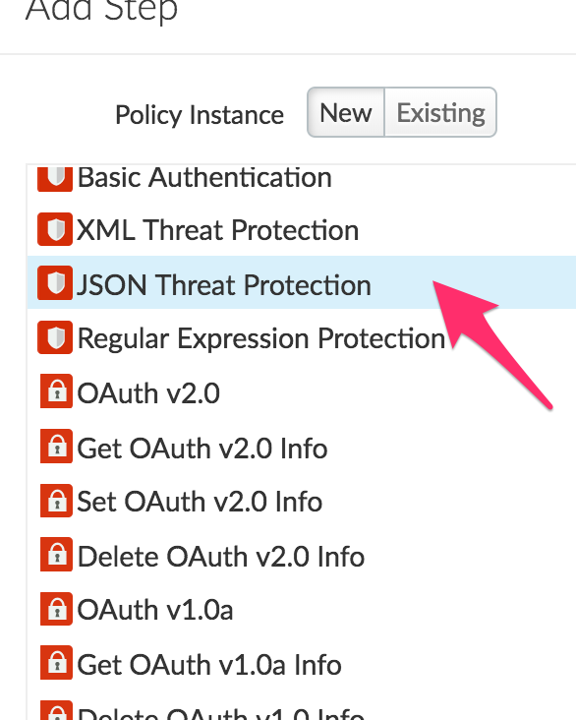
Add JSON Threat Protection
Add the JSON Threat protection policy to the [request] POST flow that you created :
<?xml version="1.0" encoding="UTF-8" standalone="yes"?>
<JSONThreatProtection async="false" continueOnError="false" enabled="true" name="JSON-Threat-Protection-1">
<DisplayName>JSON Threat Protection-1</DisplayName>
<Properties/>
<ArrayElementCount>1</ArrayElementCount>
<ContainerDepth>2</ContainerDepth>
<ObjectEntryCount>5</ObjectEntryCount>
<ObjectEntryNameLength>50</ObjectEntryNameLength>
<Source>request</Source>
<StringValueLength>250</StringValueLength>
</JSONThreatProtection>
Change the default configuration options in the policy to match the above values

Slide 6
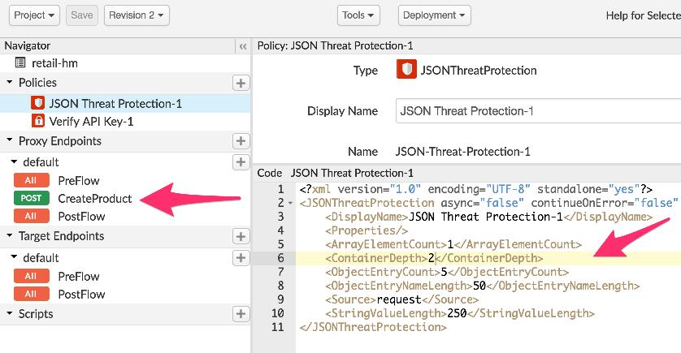
Add JSON Threat Protection

Slide 7
Test
A Product object is shown below and we need to make sure all requests adhere to this format.
NOTE: Change the name attribute value to something you can identify with later.
{
"name": "HM-BABY-STROLLER",
"category": [
"Baby"
],
"overall_rating": 9.9,
"product_name": "Navigator Stroller 3.0",
"short_description": "From newborn baby to toddler"
}
Test the endpoint with the additional payloads to trigger the JSON Threat Protection policy

Slide 8
THANK YOU

